Slide 1
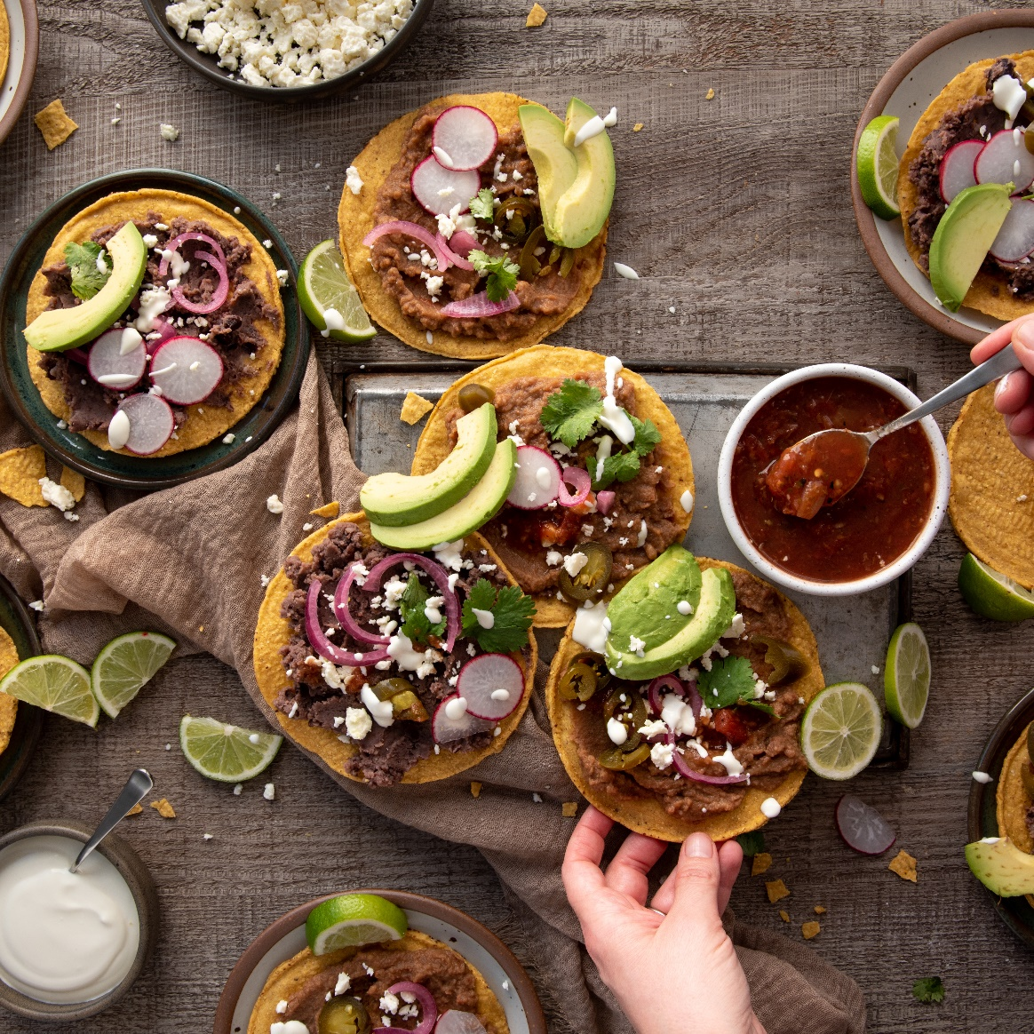
Presented by, Lekshmi R
Food Trend Analysis:
Customer Behavior and Market Insights

Slide 2
Introduction
The F&B industry has transformed rapidly due to:
Online food delivery platforms
Digital payments
Data-driven decision making
Changing lifestyles and technology have influenced how, what, and when customers order.
Understanding customer behavior is crucial for competitiveness and strategic planning.

Slide 3
Objectives
Main Goal:
To analyze and visualize customer preferences and operational insights in the F&B sector using Power BI.
Specific Objectives:
Analyze demographics and preferences
Identify product and category trends
Study order patterns and satisfaction
Compare platform-based performance
Examine regional and seasonal variations
Forecast future food trends
Develop an interactive Power BI dashboard
Provide data-driven business recommendations

Slide 4
DATASET DESCRIPTION
Field Name | Description
Order_ID | Unique identification number assigned to each customer order.
Customer_ID | Unique ID for each customer to track repeat purchases.
Customer_Name | Name of the customer (anonymized for privacy).
Age | Age of the customer, used to segment preferences across age groups.
Gender | Gender of the customer (Male/Female/Other) for demographic analysis.
City/Region | The geographical location of the customer, used for regional trend analysis.
Order_Date | The date when the order was placed, used for time-based trend analysis.
Day_of_Week | The day the order was placed (Monday–Sunday) to identify weekly patterns.
Platform | The online delivery platform used (Swiggy, Zomato, Uber Eats, Direct).
Category | Type of food ordered (e.g., Fast Food, Desserts, Beverages, Indian, Chinese).
Item_Name | Specific food item ordered, e.g., Pizza, Burger, Coffee, Ice Cream.
Quantity | The number of units ordered in a single transaction.
Unit_Price | The price of one unit of the item ordered.
Total_Amount | Total revenue from each order, calculated as Quantity × Unit Price.
Payment_Mode | The method of payment (Wallet, UPI, Card, COD).
Delivery_Time (mins) | Total delivery time from order placement to completion.
Rating | Customer rating for the order on a scale of 1–5.
Season | The season during which the order was placed (Summer, Winter, Monsoon).
Discount (%) | Discount percentage applied to the order.
Repeat_Customer (Yes/No) | Indicates whether the customer has placed orders previously.
The dataset used in this project has been synthetically designed to closely represent real-world food order and customer behavior data. It contains approximately 4,000- 5000 records and 20 meaningful columns, encompassing key aspects of the F&B ecosystem such as customer demographics, order details, product categories, and satisfaction ratings.

Slide 5
TECHNOLOGY USED
Power BI – Utilized for interactive dashboard creation and visualization.
Power Query – Helped in data transformation and integration from multiple sources.
DAX (Data Analysis Expressions) – Applied for calculations, KPIs, and advanced analytics.
Microsoft Excel – Used for data cleaning and preparation before import.
Charts & Visual Tools – Used for effective data representation and storytelling.

Slide 6
Home Page (Overview and Key Metrics)
The Home Page serves as the central navigation hub of the dashboard, titled “Food Trend Analysis: Customer Behavior and Market Insights.”
It provides a structured overview of all six analytical modules that explore sales, customer behavior, product preferences, regional trends, seasonal insights, and future forecasting.
Sections Represented:
Sales Overview – Snapshot of total revenue, total orders, and ratings.
Customer Insights – Demographic and behavioral breakdowns.
Product Insights – Top categories and items.
Regional Insights – Geographic and platform-based performance.
Seasonal Trends – Temporal consumption variations.
Future Insights – Predictive analytics and strategic recommendations.

Slide 7

Sales And Revenue Analysis
The Sales & Performance Insights page provides a comprehensive view of business efficiency and profitability through key metrics such as total revenue, orders, average order value, and profit margin. Line and bar charts display revenue trends across time, highlighting weekend and evening peaks when customer activity is highest. A category-wise analysis reveals that Fast Food and Beverages contribute the largest share to revenue, while Healthy Options show steady growth among health-conscious consumers.
A funnel chart tracks the customer order journey from placement to delivery, showcasing a strong conversion rate of nearly 90%, reflecting operational effectiveness. The payment mode breakdown indicates the growing dominance of UPI and Wallet payments, especially in urban areas. Additionally, heatmaps reveal that sales are most active during Friday to Sunday evenings, aiding resource planning.
Overall, this page transforms raw sales data into actionable insights, helping the business monitor performance, identify high-demand segments, and optimize operations for improved profitability and customer satisfaction.

Slide 8
Customer Demographics and Behavior
This page focuses on profiling the customers based on demographic and behavioural data such as age group, gender, income level, and satisfaction rating. Visuals include:
Bar chart: Orders by age group
Donut chart: Gender-based order distribution
Tree map: Category preference by gender
Scatter plot: Customer rating vs. total order value
By linking demographic data with spending and preference patterns, this page helps identify key customer segments.
Insights Highlight: The analysis shows that the 18–30 age group accounts for over 45% of total orders, with females showing a slightly higher preference for desserts and beverages, while males prefer fast food and snacks. Customers with higher income levels tend to spend more per order and exhibit greater brand loyalty.

Slide 9
Product & Category Insights
The third page examines the performance of different food categories and products. Visuals include:
Stacked column chart: Revenue contribution by category
Bar chart: Top-selling items
Box plot: Rating distribution across categories
Matrix visualization: Average order value and quantity sold per category
These visuals help identify high-performing categories and items, monitor product satisfaction levels, and reveal underperforming items that need attention.
Insights Highlight: Fast food and beverages emerge as consistent leaders in both revenue and order frequency. Desserts show high customer satisfaction scores but comparatively lower volume, suggesting potential for targeted promotions. Traditional Indian cuisines maintain steady demand in Tier-2 cities, indicating regional preferences.

Slide 10
Regional & Platform Insights
This page explores geographical and platform-based performance variations. Visuals include:
Map visualization: Total revenue by region or city
Bar chart: Orders by platform (Swiggy, Zomato, etc.)
Stacked bar: Category mix per platform
Donut chart: Payment mode preference by region
KPI cards: Top-performing region and best-performing platform
Insights Highlight: The North region records the highest revenue contribution, accounting for nearly 35% of total sales. Zomato emerges as the dominant platform with 40% of orders, followed by Swiggy. Digital wallet payments are more popular in urban areas, while cash payments remain common in semi-urban regions.

Slide 11
Seasonal & Time-Based Trends
This page focuses on the temporal aspect of customer orders, analysing how seasons, time, and days of the week influence consumption patterns. Visuals include:
Line chart: Monthly sales trend
Area chart: Seasonal variations (Winter, Summer, Monsoon)
Heatmap: Hour-of-day and day-of-week patterns
Bar chart: Most ordered items per season
KPI cards: Peak month and off-peak month indicators
Insights Highlight: Data reveals that fast food peaks during weekends, while desserts and beverages are preferred in summer. The busiest ordering hours fall between 6 PM and 9 PM. Monsoon shows a noticeable rise in comfort food orders such as soups and snacks.

Slide 12
Future Insights & Recommendations
This page is dedicated to predictive insights and strategic recommendations for business growth. Visuals include:
Forecast line chart: Predicted future orders/revenue using Power BI’s forecasting feature
Gauge charts: Target vs. actual revenue and customer satisfaction
Text cards: Key recommendations and takeaways
Insights Highlight: Forecasting models suggest a potential 10–12% increase in beverage sales during Q2 if targeted promotions are applied. Data correlation between satisfaction ratings and order frequency highlights that higher-rated categories tend to drive repeat purchases.

Slide 13
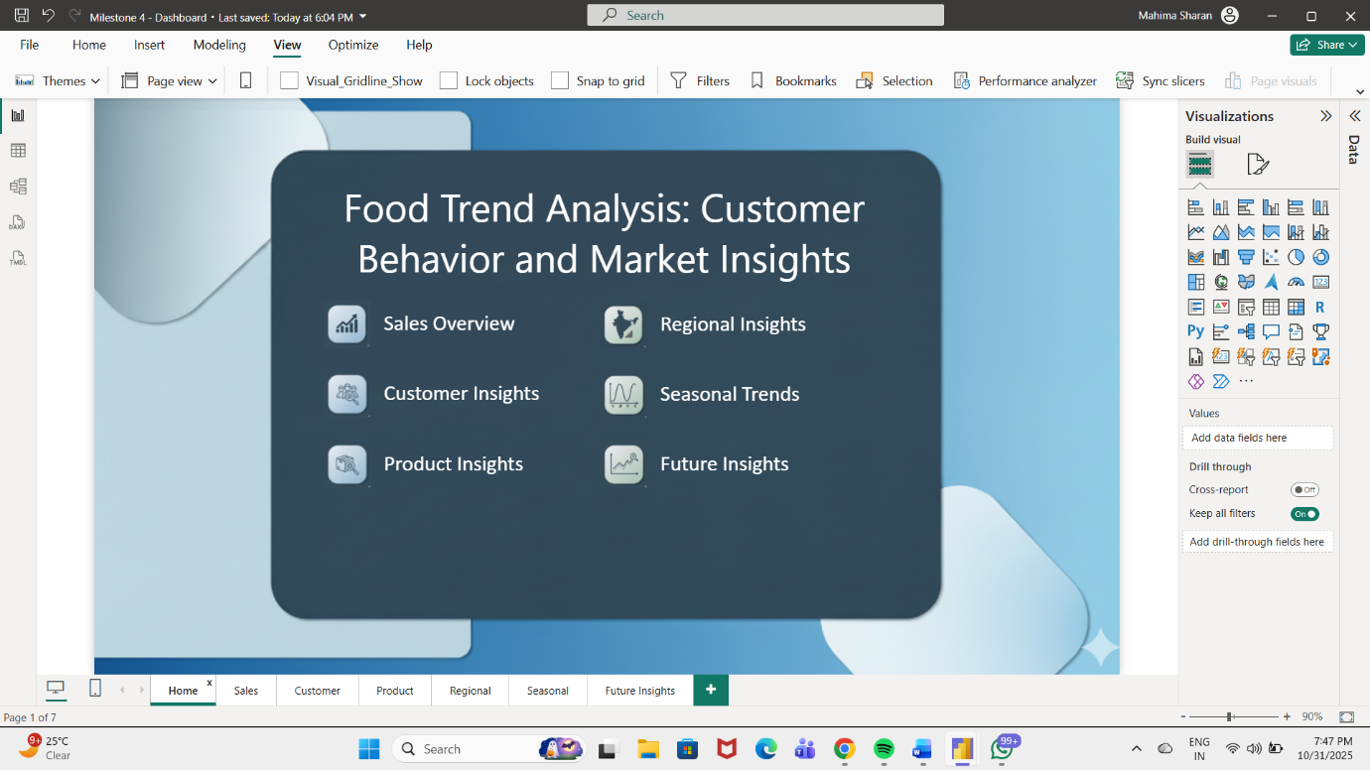
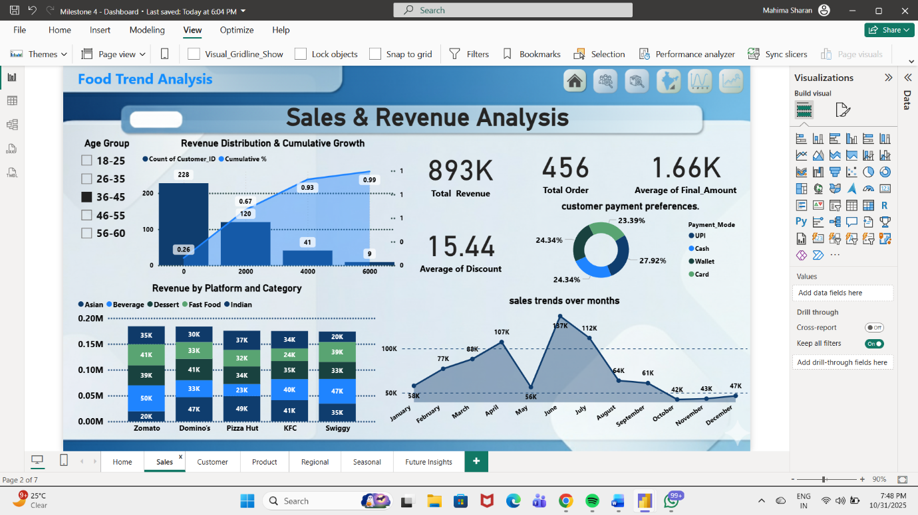
DASHBOARDS

Slide 14
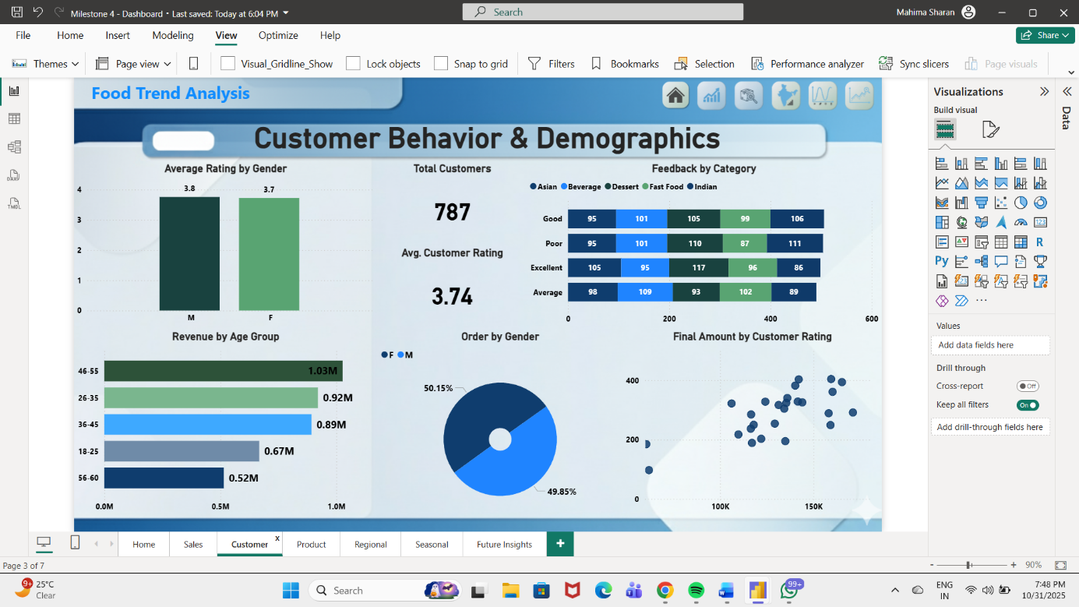
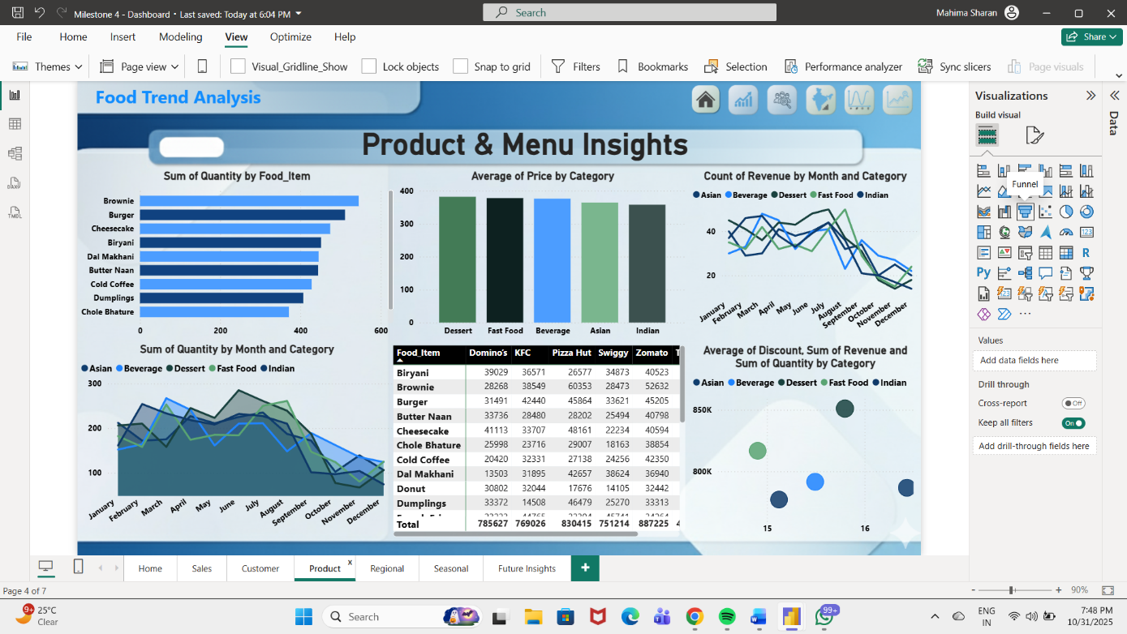
DASHBOARDS

Slide 15
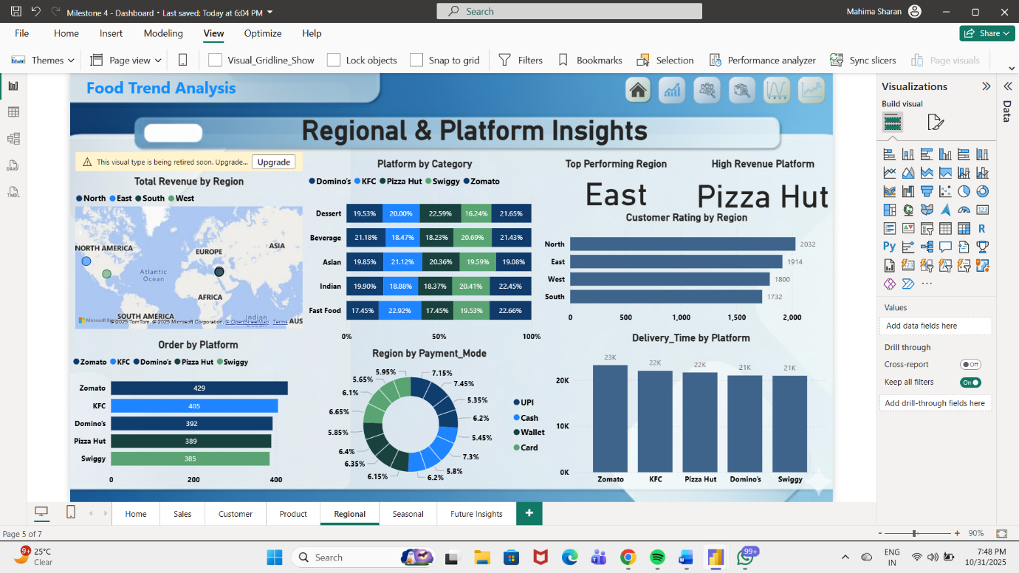
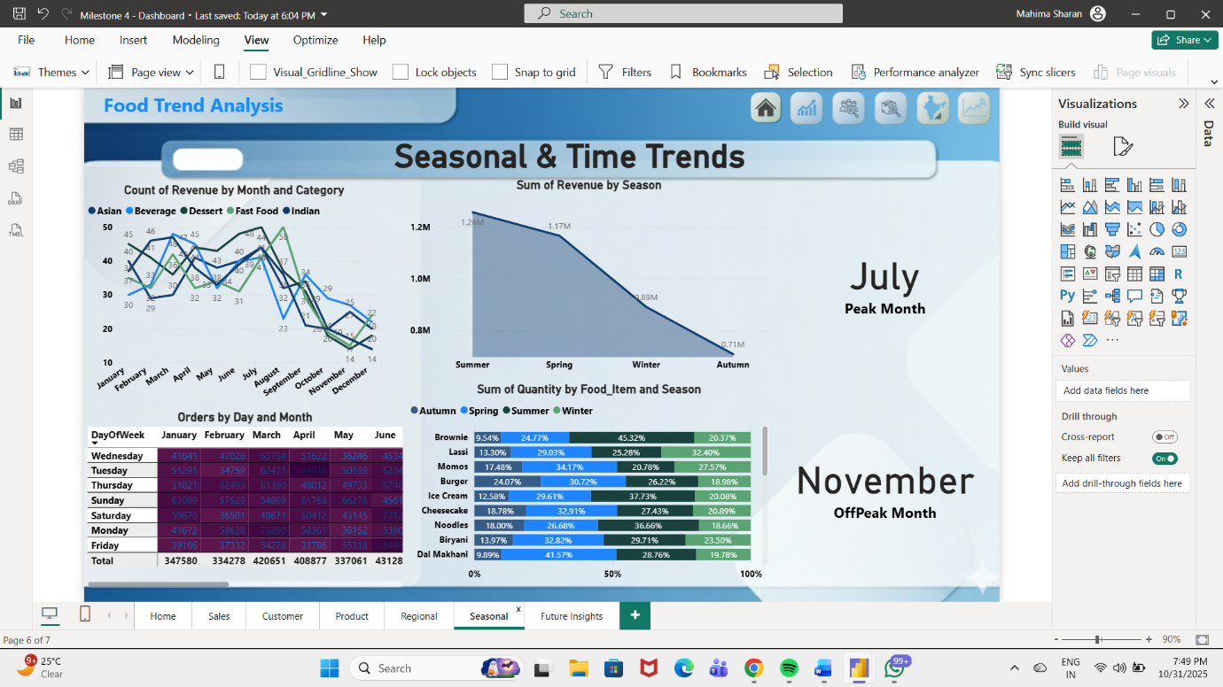
DASHBOARDS

Slide 16
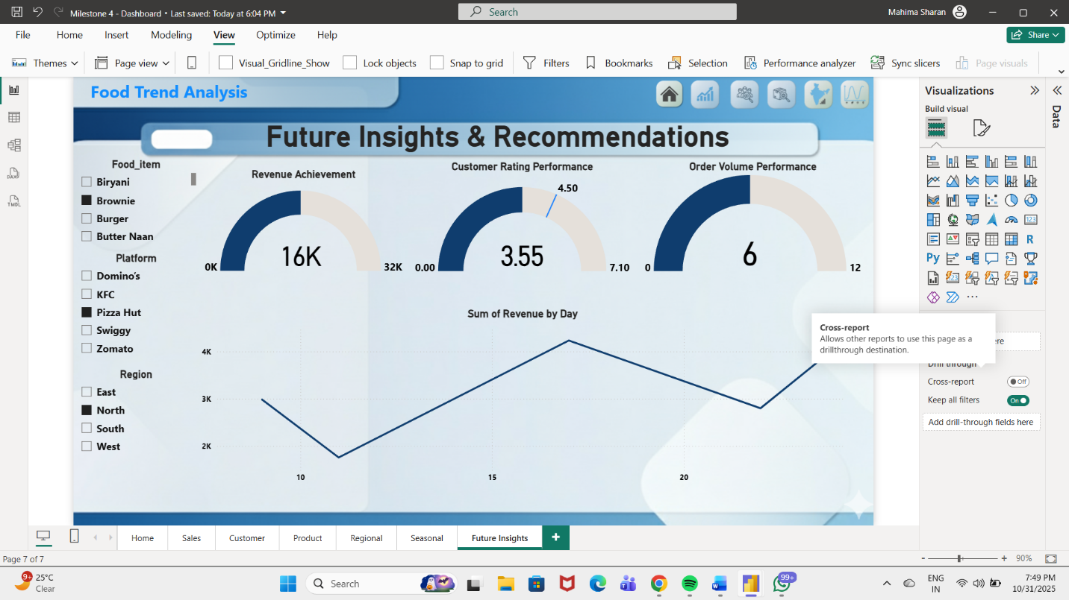
DASHBOARDS

Slide 17
KEY INSIGHTS
The Food Trend Analysis Dashboard offers a multifaceted understanding of customer behavior, market patterns, and business performance within the Food & Beverage (F&B) sector. Using data from multiple platforms, regions, and food categories, the analysis uncovers critical insights that can shape future decision-making for businesses in this domain.
Customer Preferences and Demand Trends: The analysis indicates that fast food and desserts are the most frequently ordered categories, driven by urban consumers seeking convenience and indulgence. Beverages maintain consistent demand across all seasons, highlighting their stability as a product segment. Young adults (aged 18–35) represent the largest consumer group, showing a preference for online ordering through mobile-based platforms. The average order value is notably higher among professionals residing in metro cities.
Product Performance and Pricing Patterns: The Product & Menu Insights section reveals that items such as burgers, brownies, and biryanis generate the highest revenue. Despite moderate pricing, these items show high order frequency, demonstrating a strong price-demand correlation. Premium categories such as Asian cuisine have fewer orders but higher margins, suggesting a niche yet profitable market. The dashboard also identifies cross-category relationships—for instance, dessert orders often correlate with beverage purchases, indicating upselling potential.

Slide 18
Regional and Platform Analysis: Regional insights highlight that the North and West zones dominate in total revenue contribution. Metro cities like Delhi, Mumbai, and Bengaluru show the highest order volumes, while smaller cities display growing engagement with wallet-based and online payments. Among delivery platforms, Swiggy and Zomato collectively account for nearly 80% of the total sales, but the performance varies by region—Zomato leads in metro areas while Swiggy performs better in suburban zones.
Temporal and Seasonal Trends: The time-based analysis shows clear ordering peaks during weekends and evenings, aligning with leisure and family dining behavior. Seasonal variation indicates that desserts and beverages are more popular in summer, while fast food and Indian cuisine dominate in winter months. The line and area charts emphasize how promotional offers and festive seasons significantly influence purchase frequency and category preference.
Operational and Marketing Insights: The dashboard highlights the impact of discount strategies on driving order volume. Average discounts between 10–15% show a strong positive effect on both order count and customer retention. Moreover, customer ratings correlate with repeat purchase frequency, emphasizing the importance of product quality and service consistency.
Overall, these insights provide a clear understanding of how menu diversity, pricing, marketing, and customer experience collectively shape business success in the competitive F&B marketplace.

Slide 19
FUTURE INSIGHTS
The Future Insights section leverages Power BI’s predictive capabilities and analytical reasoning to provide forward-looking observations and business recommendations that can optimize growth and profitability.
Forecasting Customer Demand: Predictive analysis indicates a 10–12% projected growth in beverage and fast-food categories during the next quarter. Seasonal forecasting suggests that promotional campaigns aligned with festivals or summer months can significantly boost order volumes.
Strategic Recommendations:
Enhance Digital Engagement: Introduce personalized offers through app notifications and loyalty programs to maintain customer retention.
Diversify Menu Options: Introduce healthy alternatives and fusion cuisines to appeal to emerging health-conscious consumers.
Optimize Pricing and Discounts: Implement region-specific dynamic pricing and limited-time discounts to maintain competitiveness.
Focus on Underperforming Regions: Launch targeted ad campaigns and delivery partnerships in low-revenue zones to balance market distribution.
Sustainability Initiatives: Highlight eco-friendly packaging and sustainable sourcing as key differentiators in urban markets.

Slide 20
Platform Strategy and Operational Improvement:\
Swiggy and Zomato should collaborate with restaurant partners to improve delivery times and customer satisfaction ratings. Power BI’s forecasting charts reveal that platforms focusing on faster delivery and superior app experience show a direct impact on order recurrence and rating improvement.
Performance Optimization through Data:
Businesses can use the KPI and gauge metrics to set target vs. actual performance benchmarks for revenue, ratings, and delivery time. Integrating these insights with real-time tracking can enhance decision-making precision and responsiveness.

Slide 21
Key Recommendations
Increase promotional efforts for fast food and beverages during seasonal peaks.
Strengthen partnerships with Swiggy in high-performing regions.
Launch targeted campaigns in underperforming regions.
Enhance digital wallet offers to encourage online payments.
Use feedback analytics to improve quality in low-rated product categories.

Slide 22
CONCLUSION
The project “Food Trend Analysis: Customer Behavior and Market Insights” demonstrates how Power BI transforms raw data into actionable business intelligence for the Food & Beverage industry.
Combined analysis of Sales, Customer, Product, Regional, Seasonal, and Forecasting dashboards offers a complete understanding of consumer behavior and business performance.
Insights reveal:
Fast food & desserts dominate orders.
Beverages show stable year-round demand.
Swiggy & Zomato contribute ~80% of total revenue.
Digital payments are stronger in urban areas.
Weekends & festivals see peak engagement.
Power BI enabled interactive exploration through slicers, KPIs, and visuals—turning complex data into clear, accessible insights.
The project highlights how data-driven decisions enhance marketing, product strategy, and operational efficiency.
Integrating historical and predictive analytics enables proactive business planning and sustainable growth.
Overall, the dashboard stands as a strategic decision-support tool—bridging data, analytics, and storytelling to drive long-term success.

Slide 23
THANK YOU

